Slide 1
KMOU Division of Marine System Engineering
Introduction to
Internal Combustion Engine

Slide 2
Lesson content for each week
Ch0_Introduction to the Class | Ch6_Piston Fittings and Crankshaft
Ch1_Overview of the Internal Combustion Engine | Ch7_Lube Oil System
Ch2_Thermodynamics and Compressed Air System | Ch8_Cooling Water System
Ch3_Marine Fuels and Internal Fuel Oil System | Ch9_Introduction to the Main Engine
Ch4_Intake and Exhaust System | Ch10_Alternative Fuels and Alternative Fuel Systems
Ch5_Turbocharger | Ch11_Environmental Regulations and Exhaust Gas Aftertreatment Systems
Midterm | Ch12_Tools, Apprentice Engineer Duties, and Career Direction
 | Final Exam

Slide 3
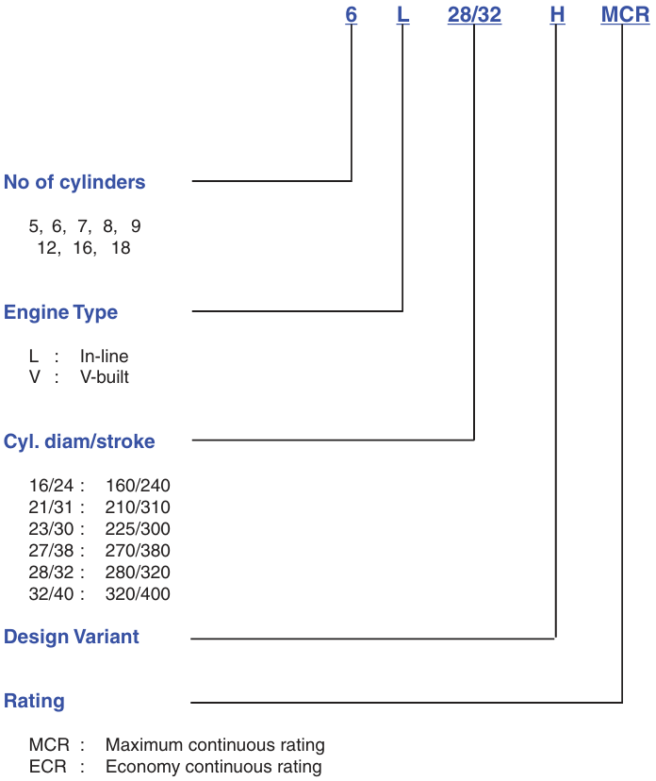
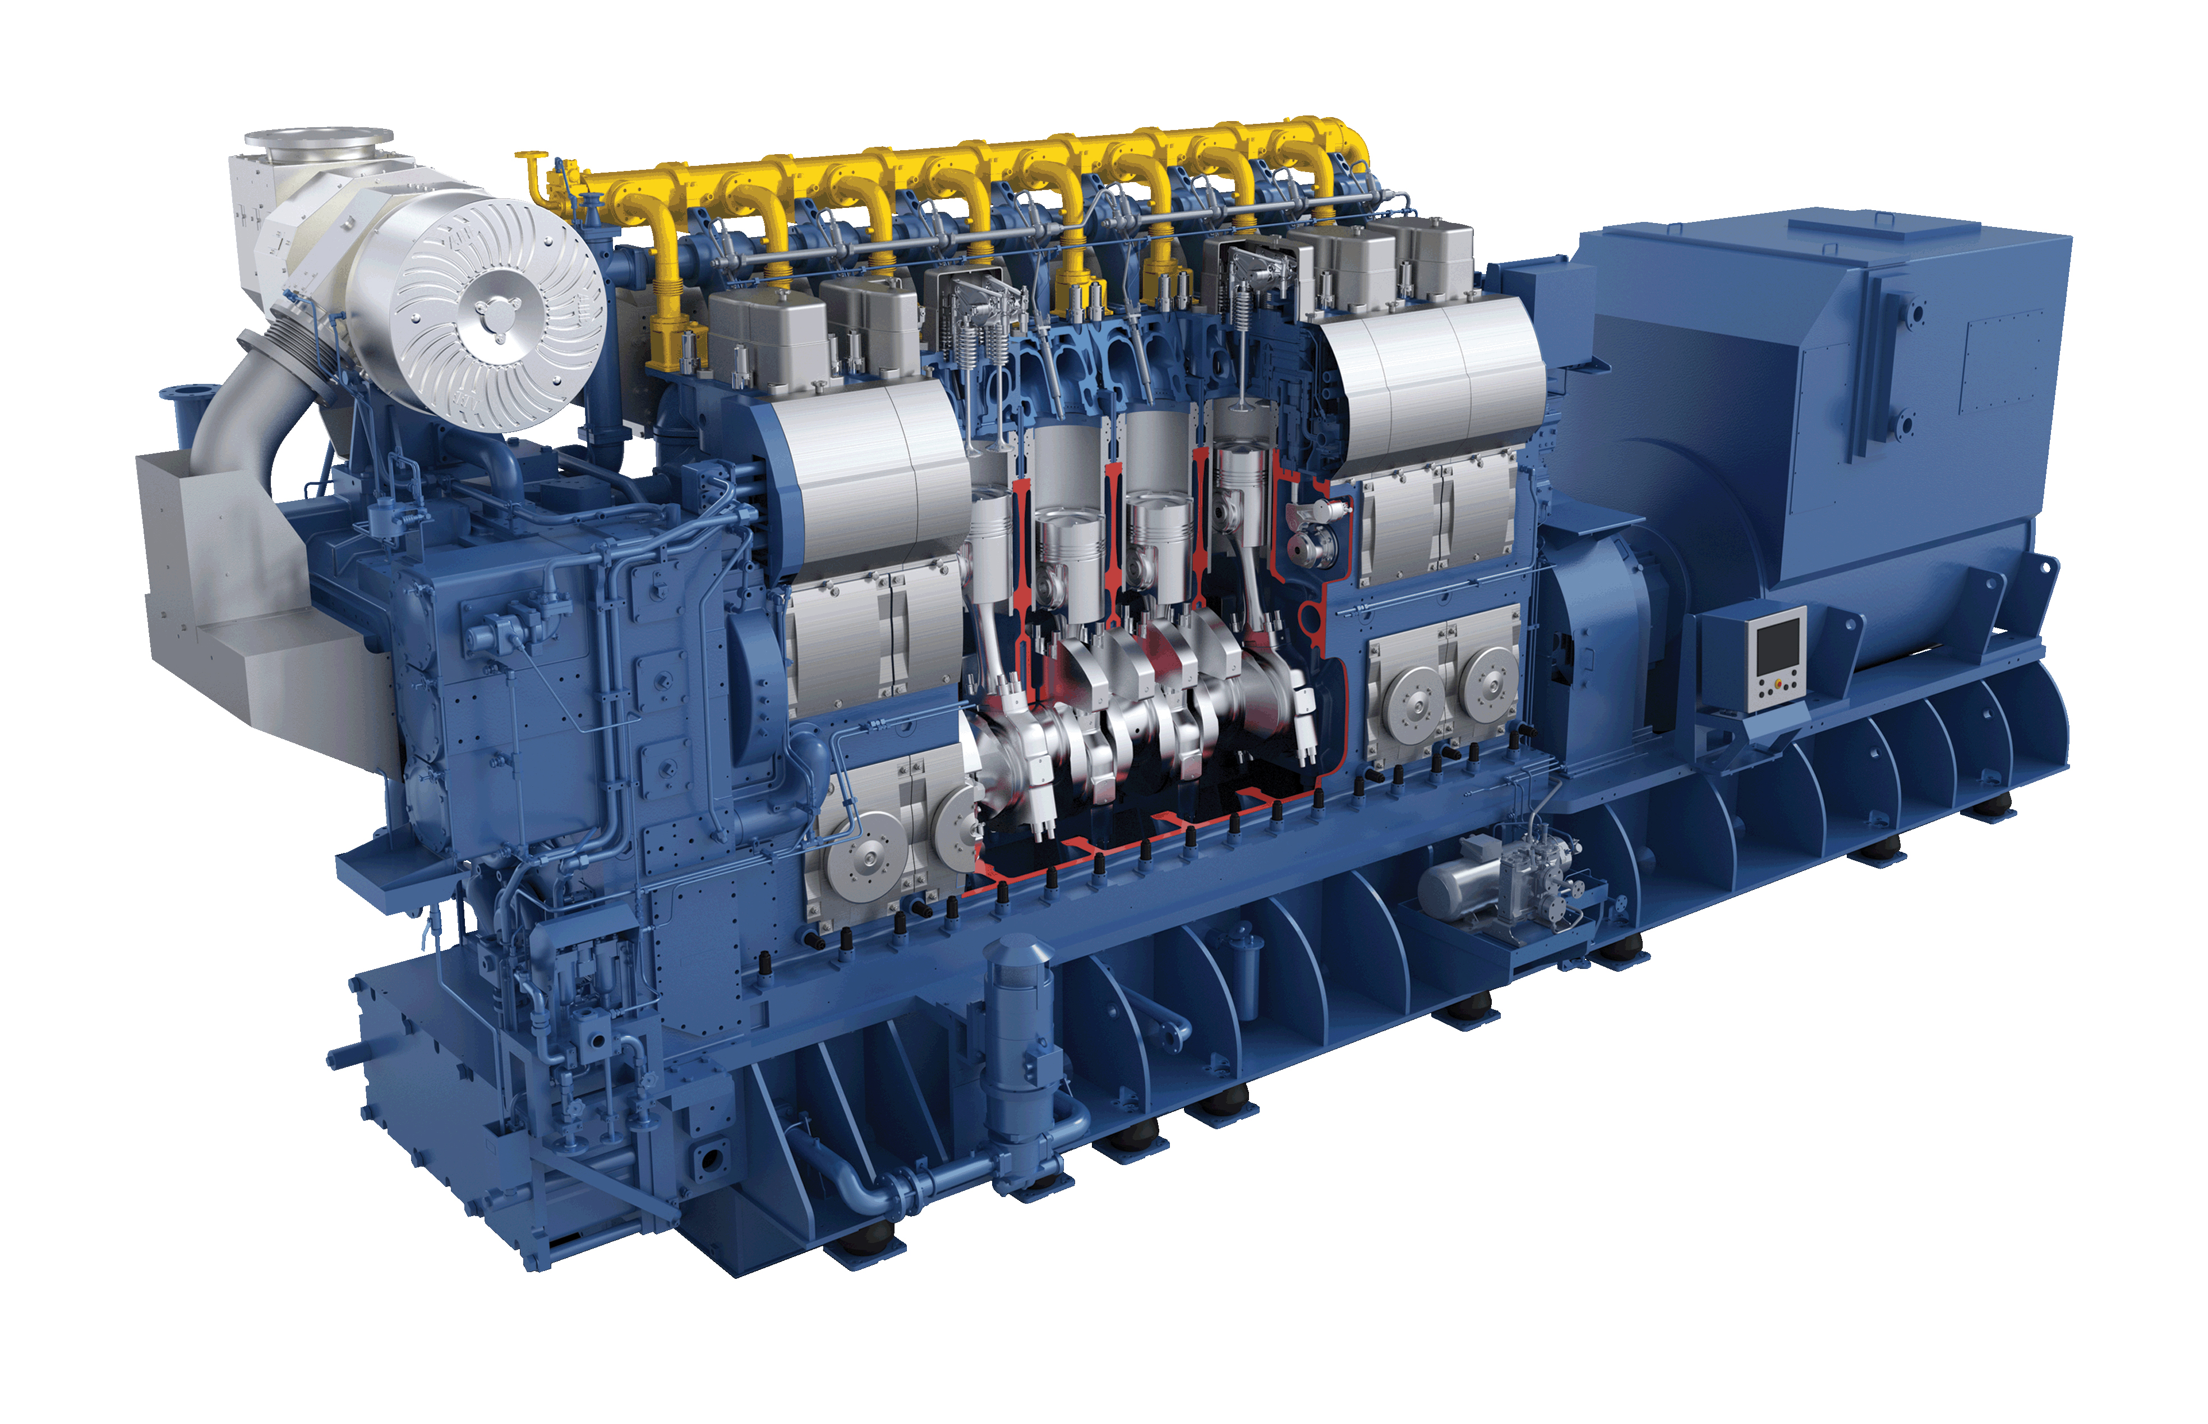
Engine type identification for MAN B&W
G/E (In-line type) with 8 cylinders

Slide 4
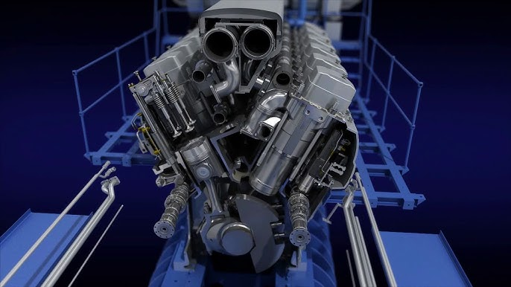
Engine type identification for MAN B&W
G/E (V-built type)

Slide 5
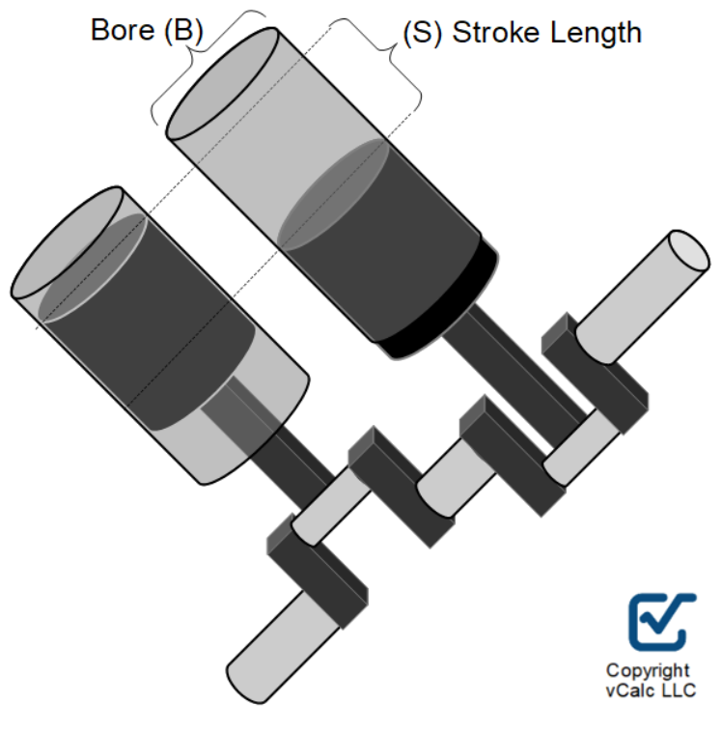
Engine type identification for MAN B&W
Bore : 280 mm
Stroke : 320 mm

Slide 6
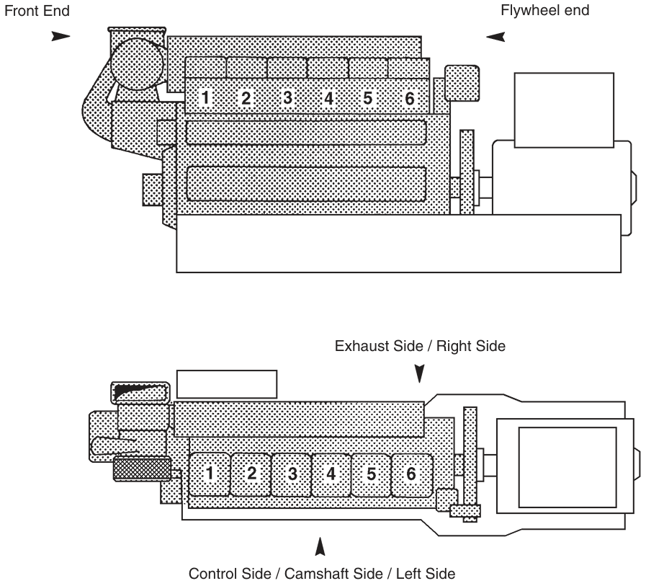
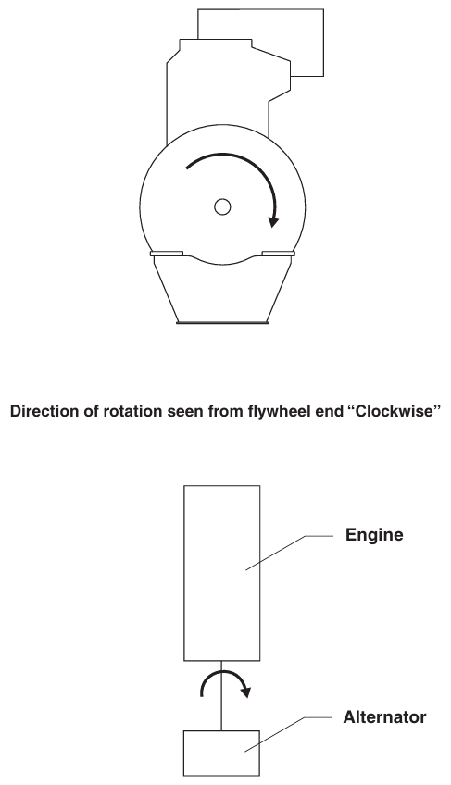
Engine type identification for MAN B&W

Slide 7
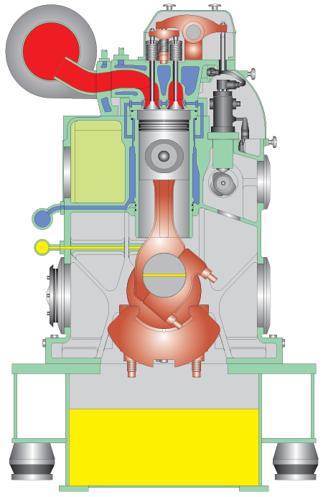
Piston
Cylinder liner
Connecting rod

Slide 8
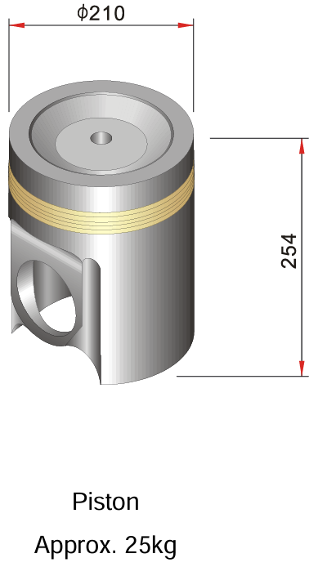
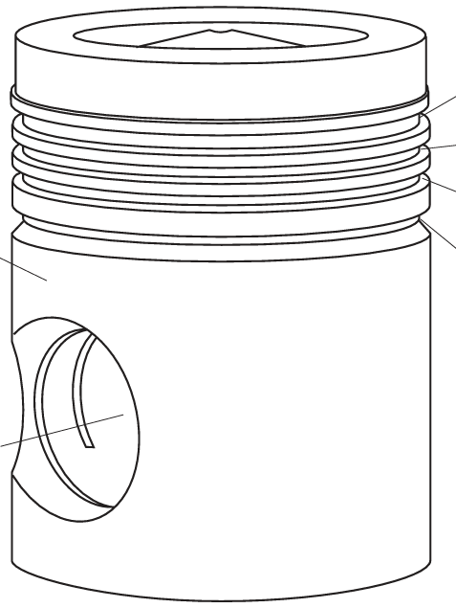
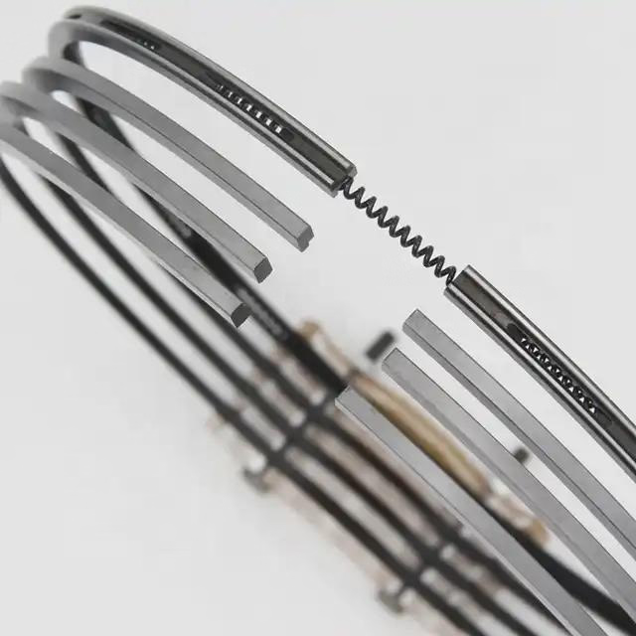
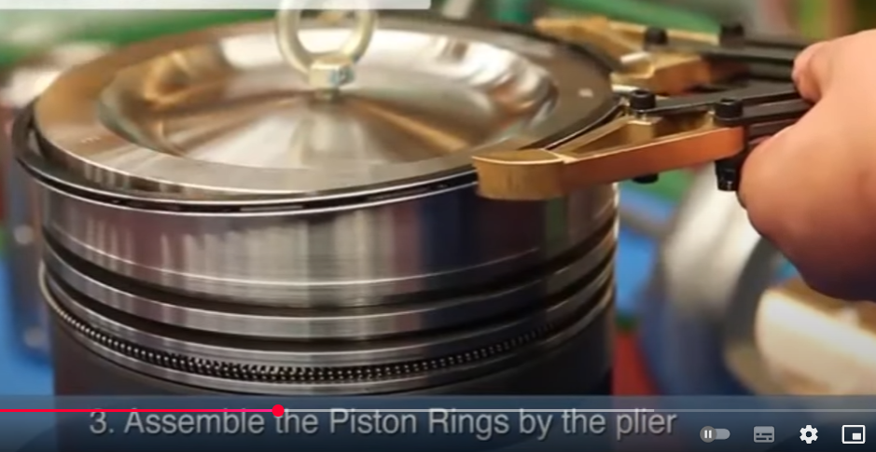
Piston
3 compression rings can be inserted in these ring grooves
The piston, which is oil-cooled and of the monobloc type made of nodular cast iron, is equipped with 3 compression rings and 1 scraper ring.
By use of a combination of compression rings with different barrel-shaped profiles and chrome-plated running surface on all rings, the piston ring pack is optimized for maximum sealing effect and minimum wear rate.
Piston
1 oil scraper ring can be inserted in this ring groove
1 compression ring is being inserted by special ring opener
2 compression rings can be inserted in these ring grooves
1 oil scraper ring was inserted in the ring groove
Notes:
Monobloc : 일체주조의
nodular cast iron : 구상 흑연 주철

Slide 9
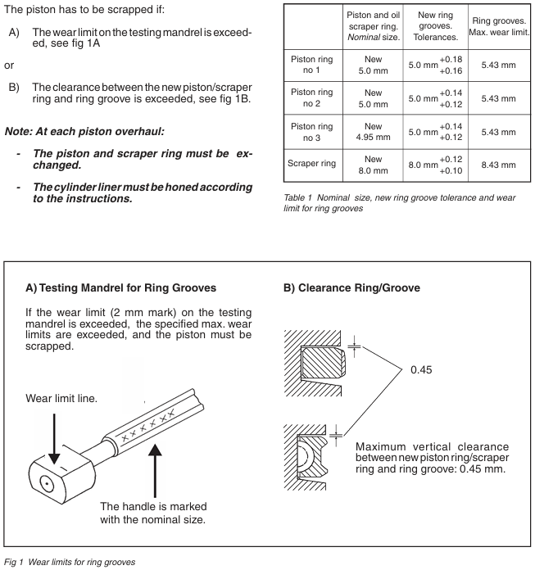
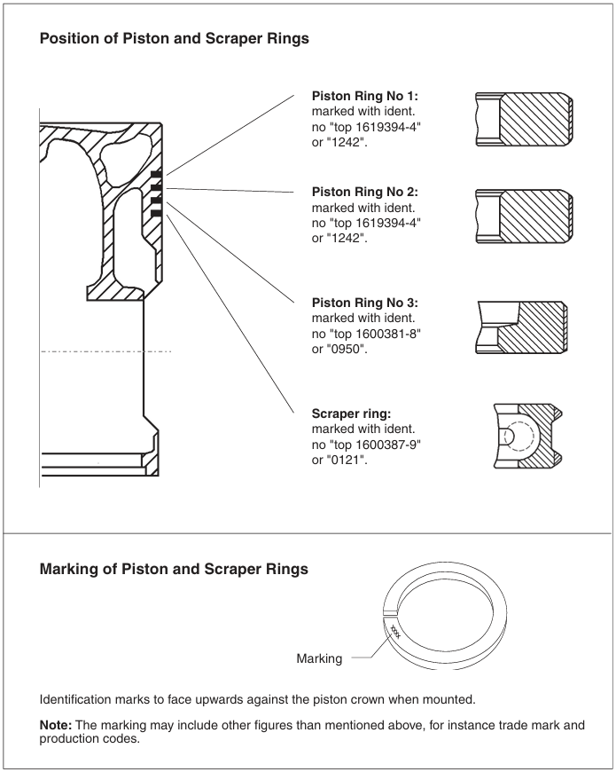

Slide 10
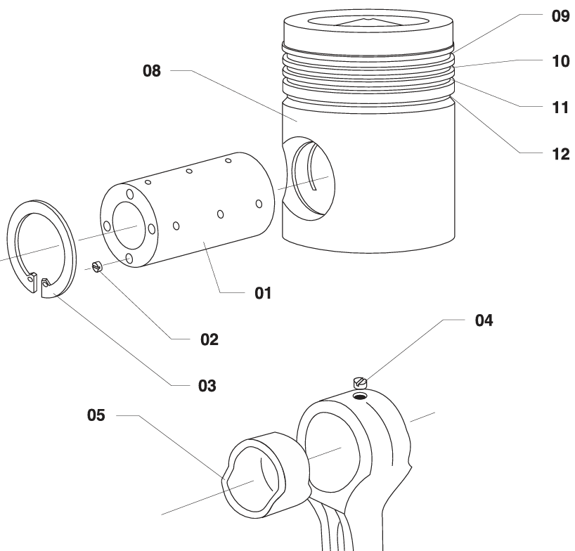
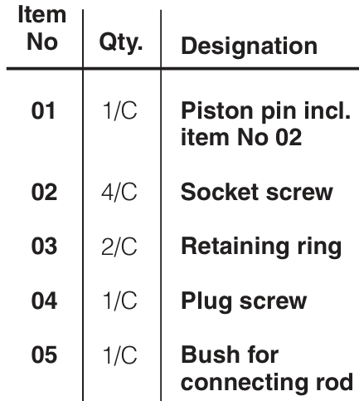
Piston pin
The piston pin is fully floating which means that it can turn freely in the pin bosses of the piston as well as in the connecting rod bush.
The piston pin is prevented from moving in the axial direction by two circlips (retainer rings).

Slide 11
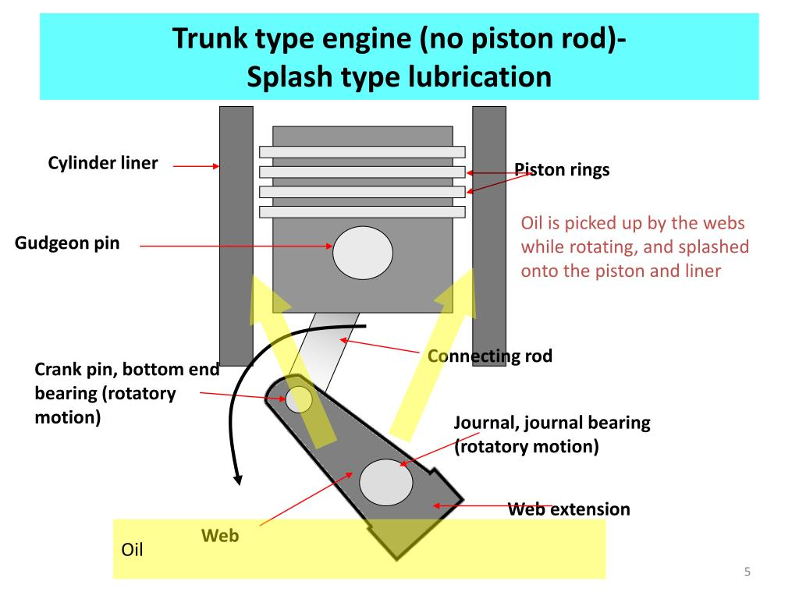
Lubrication between piston and cylinder liner
Lubrication of the cylinder liner and piston rings is primarily done by splash oil from the revolving motion of the crankshaft and oil vapor from the crankcase.

Slide 12
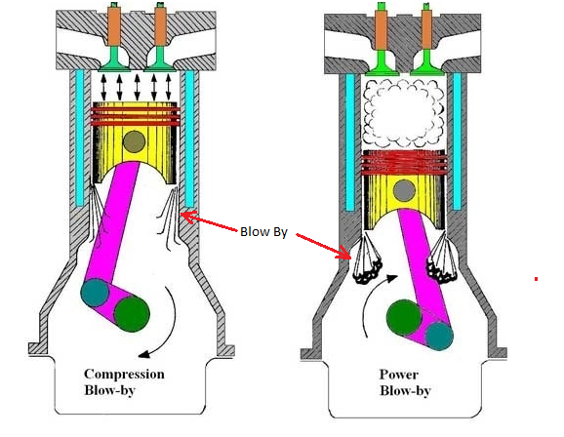
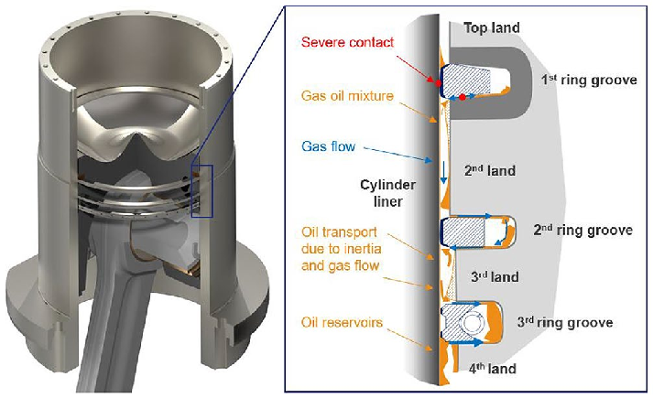
Lubrication between piston and cylinder liner
Lubrication oil is present between the piston rings and the cylinder liner to maintain a sealing effect for the combustion chamber.
Otherwise, a "blow by" phenomenon occurs, in which combustion gases leak into the crank chamber.

Slide 13
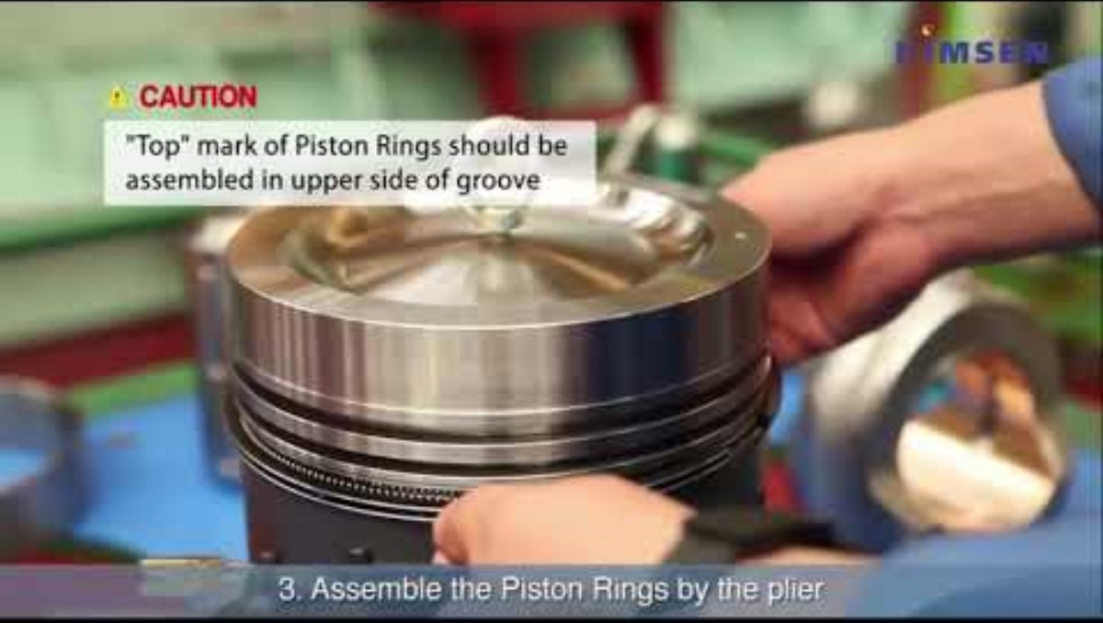
Piston

Slide 14
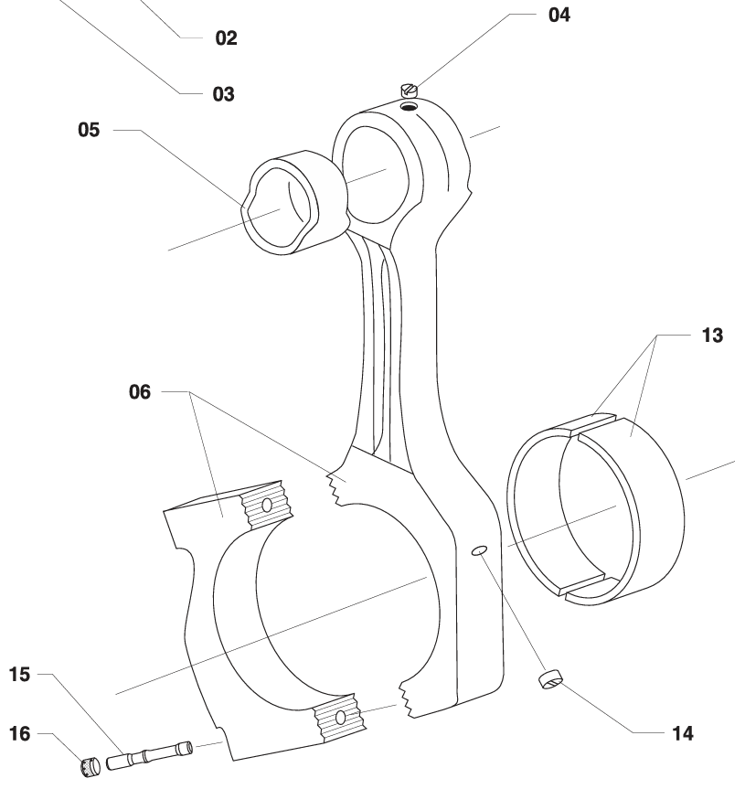

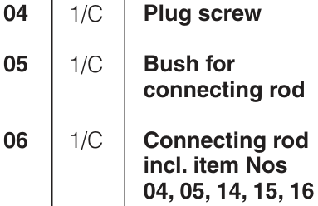
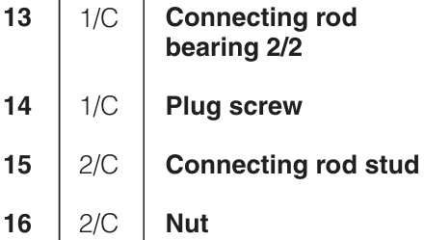
Connecting rod
The connecting rod is die-forged. The big-end has an inclined joint in order to facilitate the piston and connecting rod assembly to be withdrawn up through the cylinder liner. The joint faces on the connecting rod and the bearing cap are serrated to ensure precise location and to prevent relative movement of the parts.
Notes:
Inclined : 경사
Serrated : 톱니모양의

Slide 15
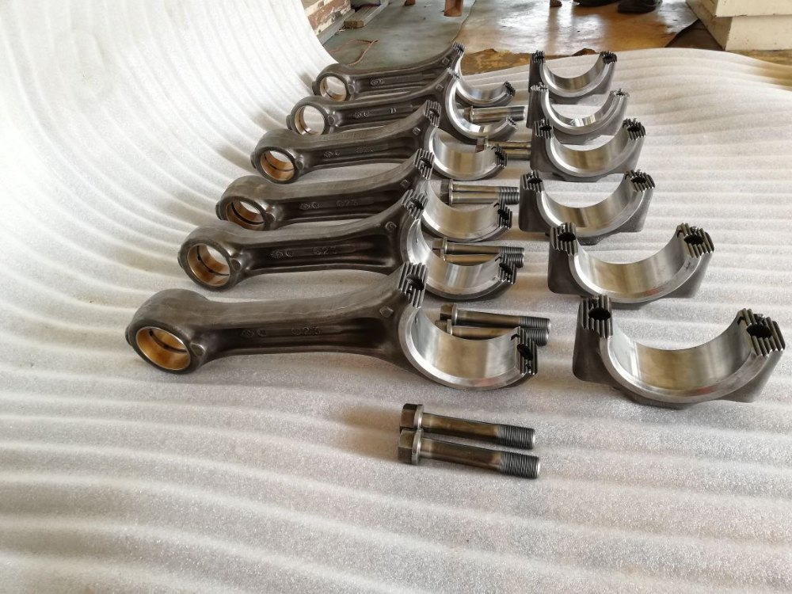
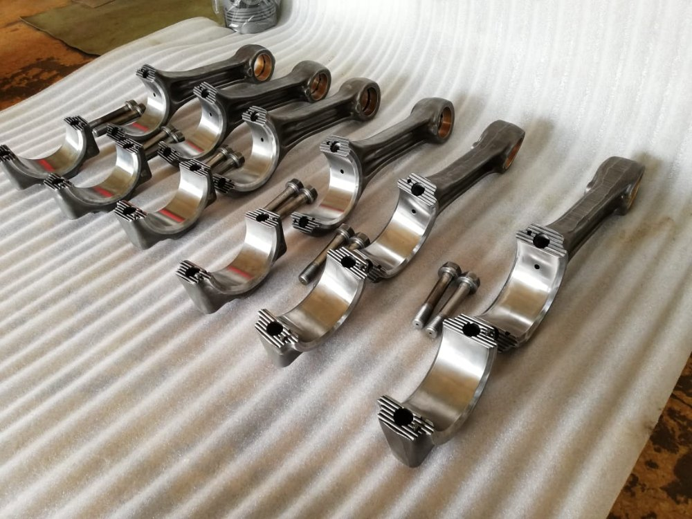
Connecting rod
2 connecting rod bolts

Slide 16
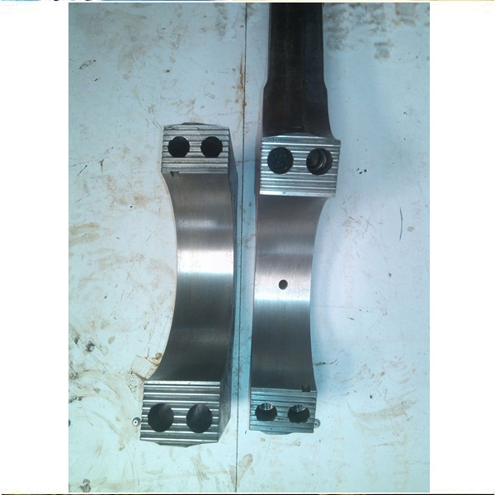
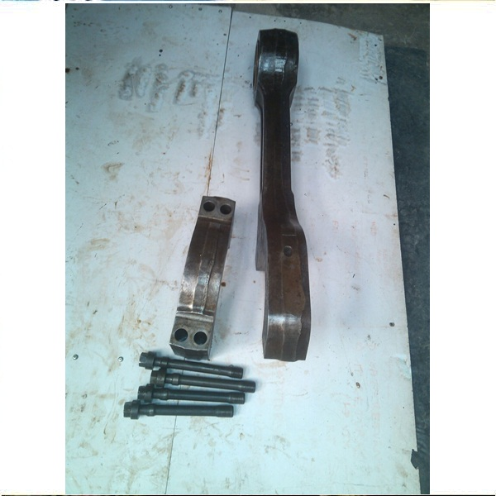
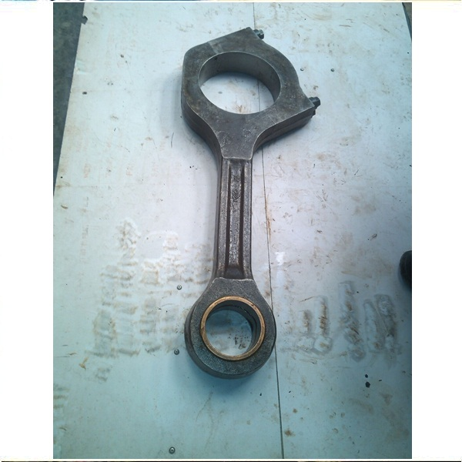
Connecting rod
4 connecting rod bolts

Slide 17
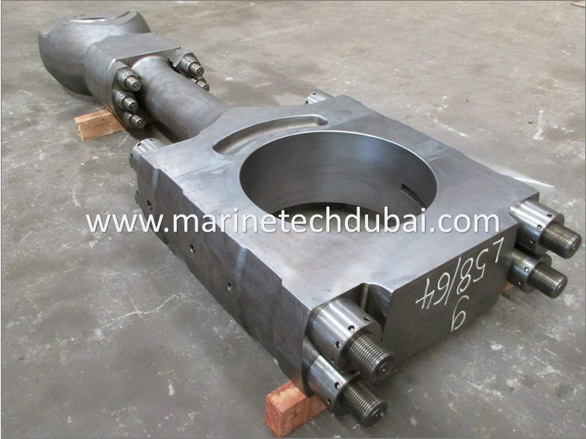
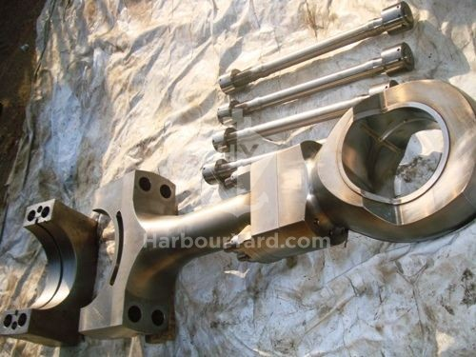
Connecting rod
Some G/E models use 4 studs and 8 hydraulic nuts for connecting rod

Slide 18
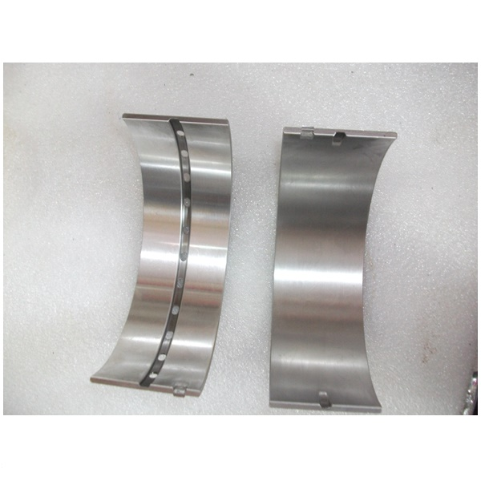
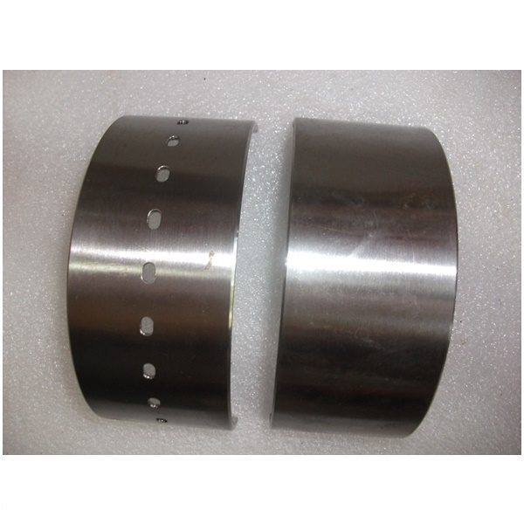
Connecting rod bearing

Slide 19
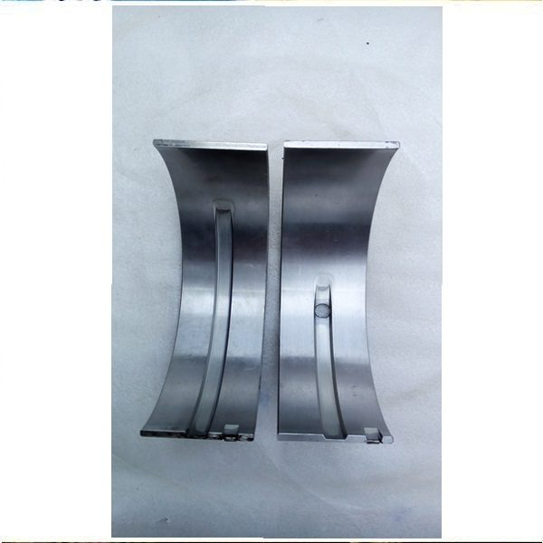
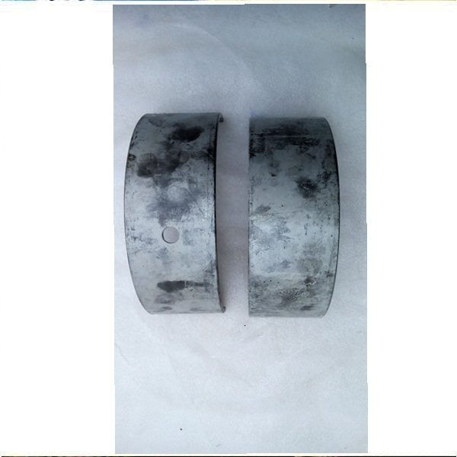
Connecting rod bearing

Slide 20
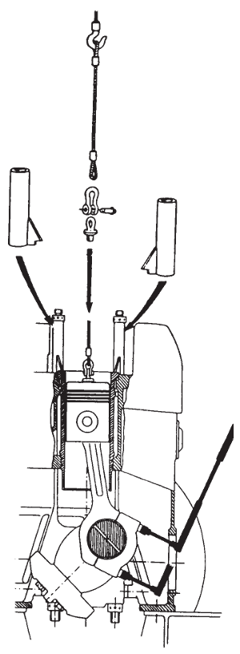
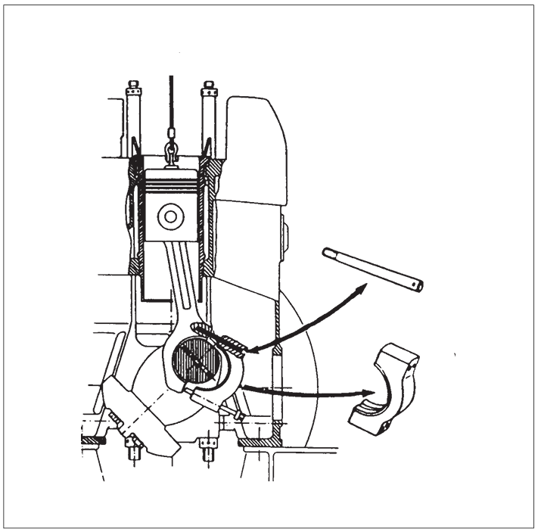
Dismounting of piston and connecting rod

Slide 21
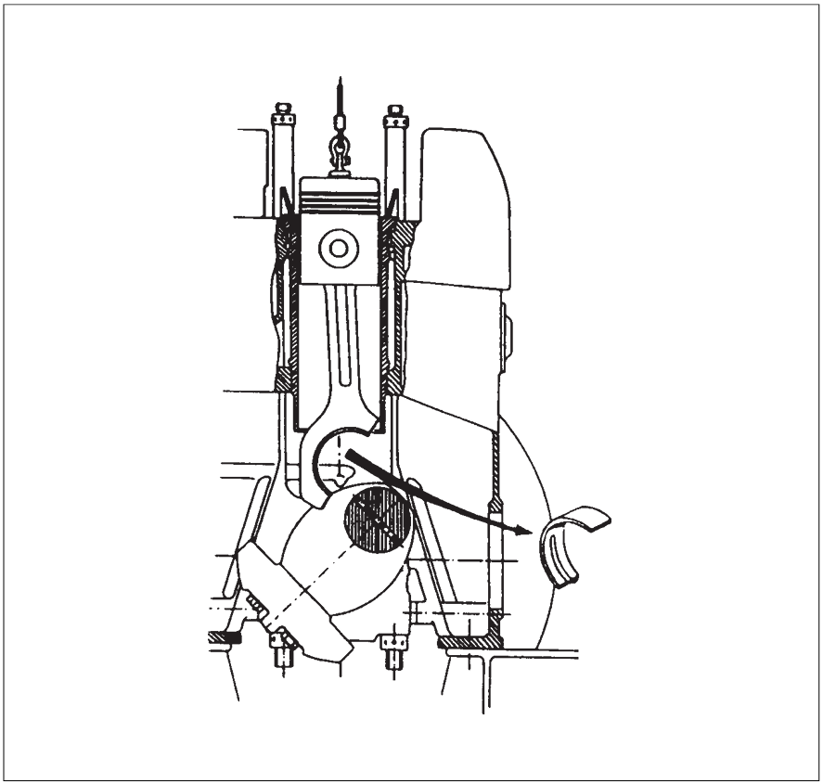
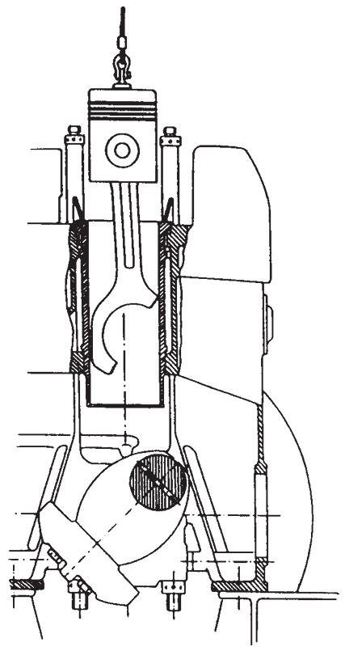
Dismounting of piston and connecting rod

Slide 22
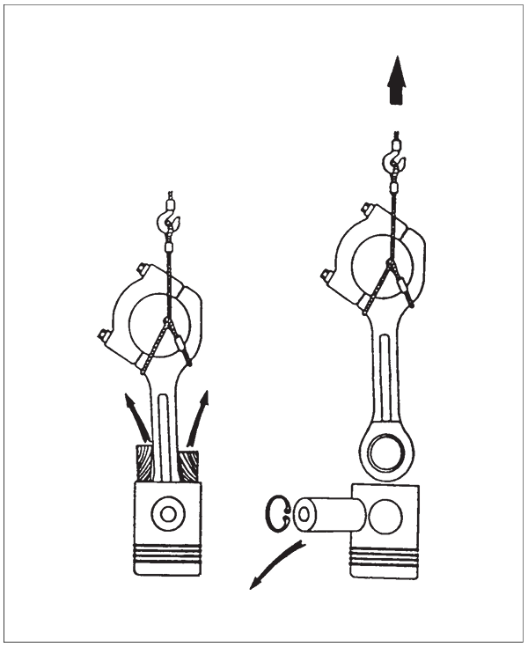
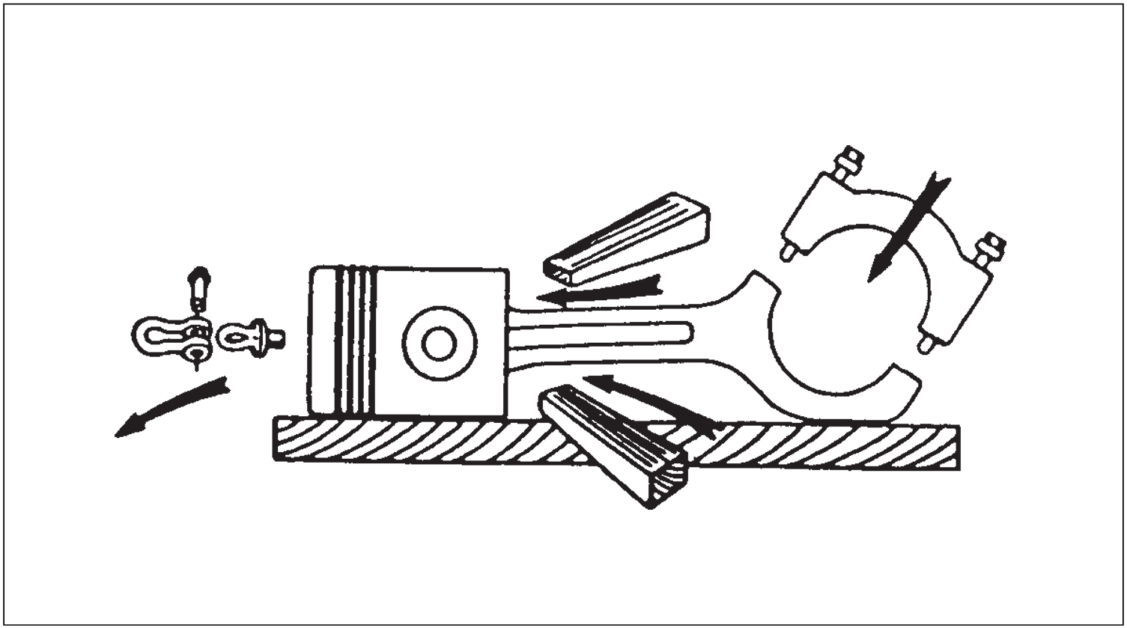
Separation of piston and connecting rod

Slide 23
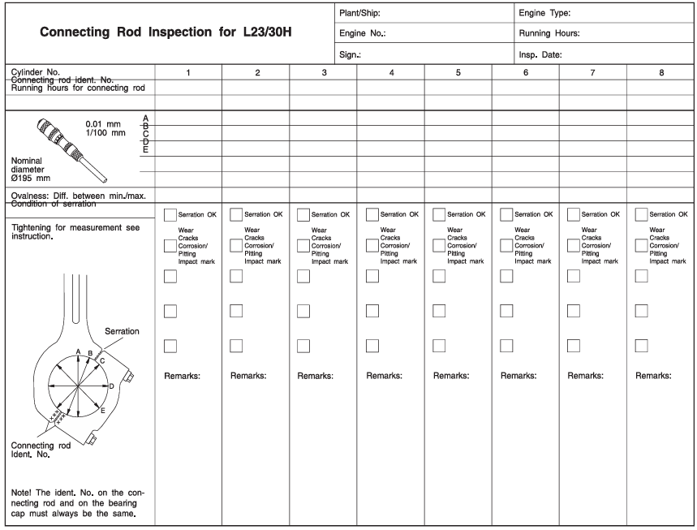
Connecting rod inspection

Slide 24
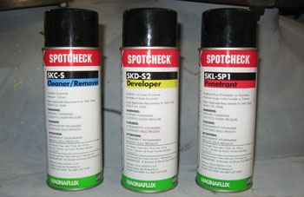
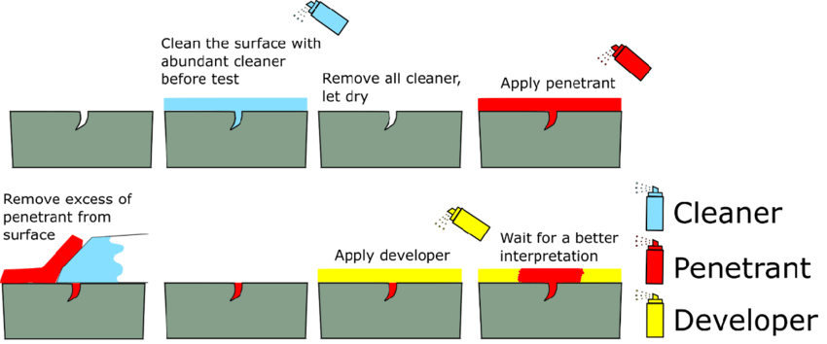
Liquid penetrant test

Slide 25
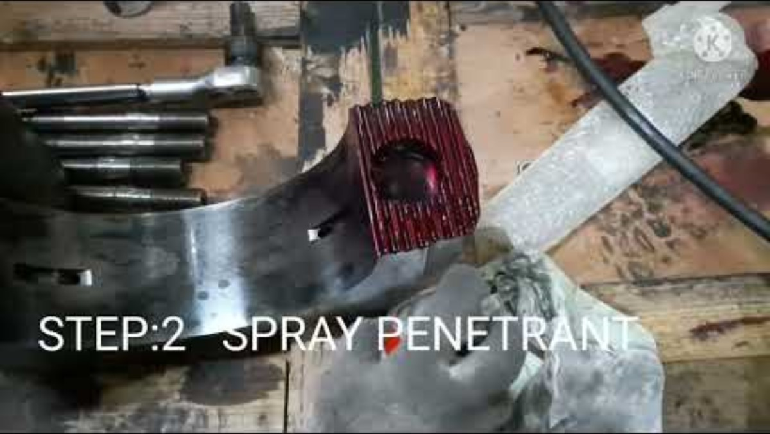
Liquid penetrant test

Slide 26
Criteria for replacement of connecting rod big-end and main bearing shells (only reference)

Slide 27
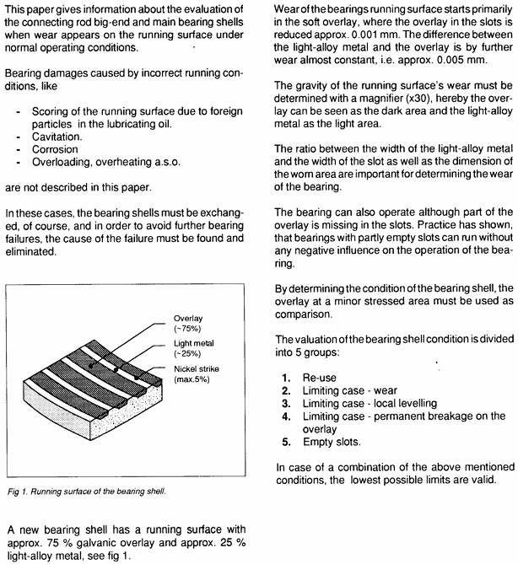

Slide 28
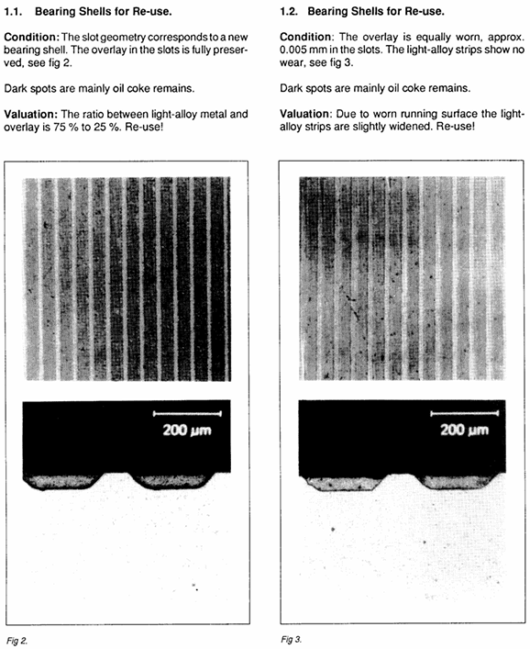

Slide 29
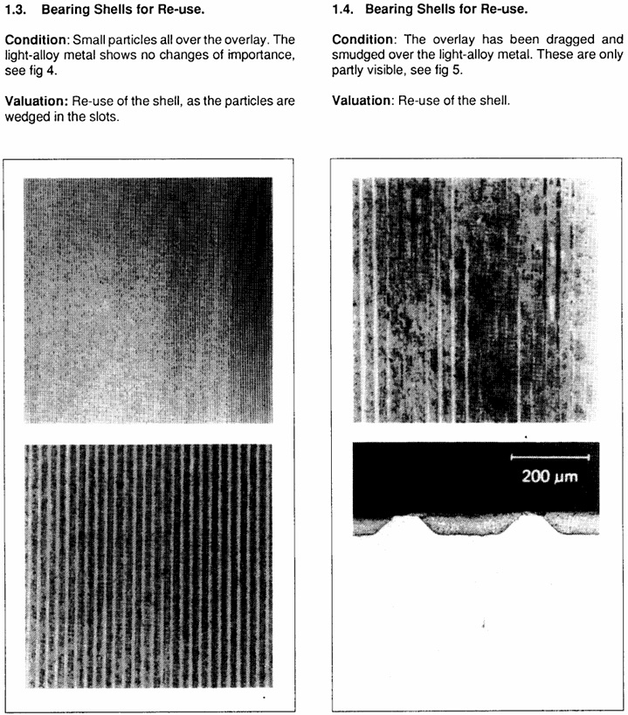

Slide 30
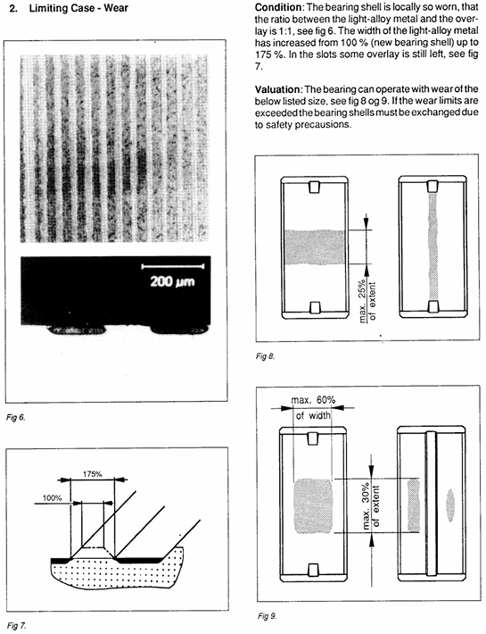

Slide 31
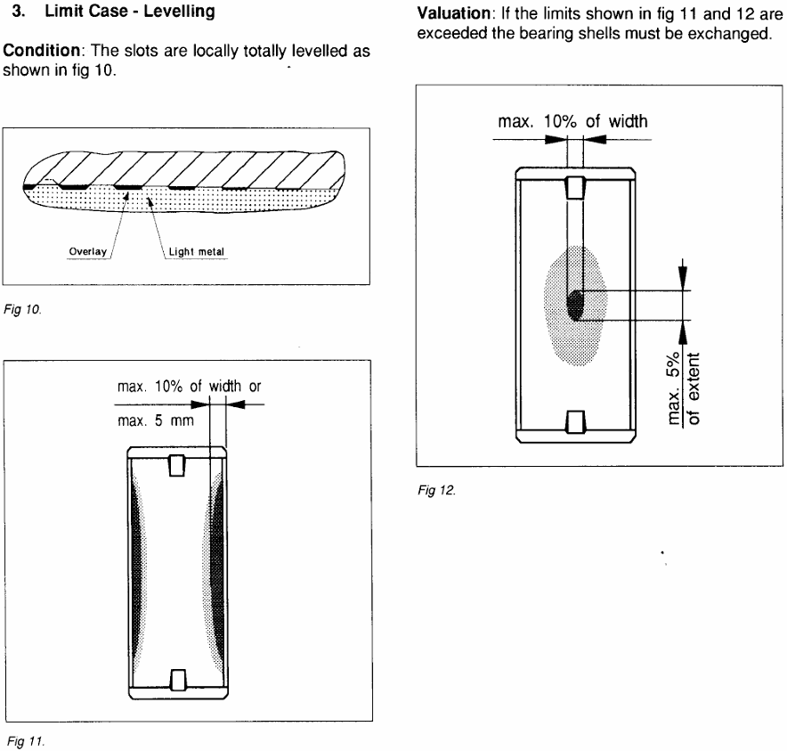
Notes:
Level : 평평한

Slide 32
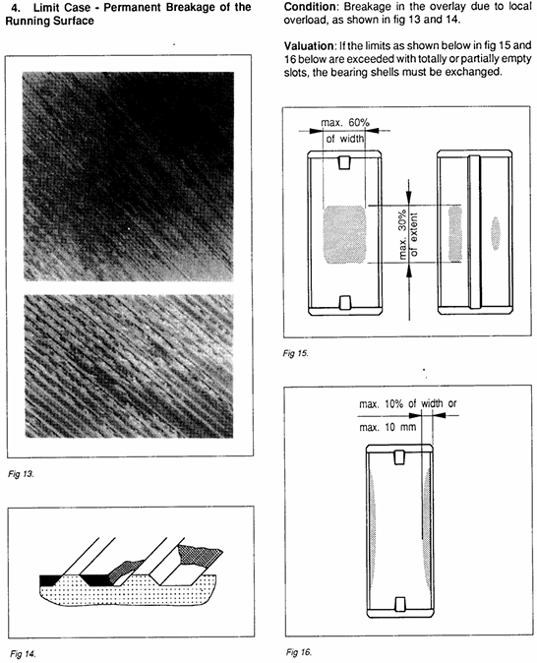

Slide 33
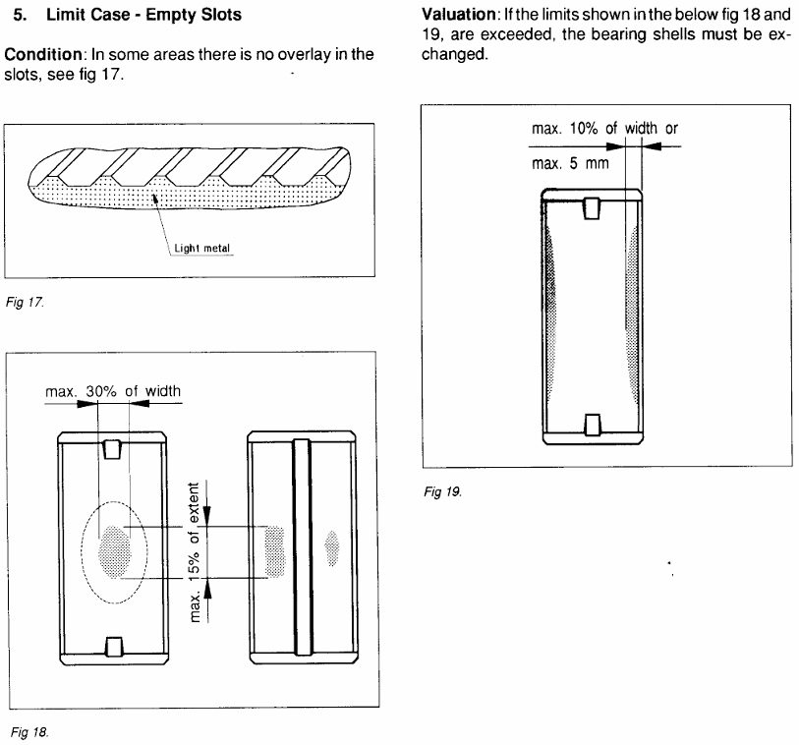

Slide 34


Mounting of piston and connecting rod

Slide 35


Mounting of piston and connecting rod

Slide 36

Mounting of piston and connecting rod

Slide 37

Cylinder liner
Hexagon screw
O-ring
Washer
Sleeve
Sleeve
O-ring
Water guide jacket
The cylinder liner is made of fine-grained, pearlite cast iron and is fitted in a bore in the engine frame.
Replaceable cast iron sealing rings are fitted between the liner and the cylinder head and between the liner and the frame.
The liner is clamped by the cylinder head and is guided by a bore at the bottom of the cooling water space of the engine frame. The liner can thus expand freely downwards, when heated during the running of the engine.
Sealing for the cooling water is obtained by means of silicone rubber rings which are fitted in grooves machined in the liner.
O-ring
Sealing ring
Plug screw
Water guide jacket
O-ring
Sealing ring
Cooling water connection
O-ring
Flame ring
Sealing ring
Cylinder liner
O-ring

Slide 38


Cylinder liner
From the top view
Top
2 o-rings are inserted here
1 sealing ring is placed here

Slide 39


Cylinder liner
Chain block
If the inner wear of the cylinder liner is severe, it is removed and replaced with a new one, as shown in the photo on the left.
After fixing the chain block to the ceiling, hang the cylinder liner on the hook and slowly pull it up.
Notes:
Inclined : 경사
Serrated : 톱니모양의

Slide 40
Piston
Cylinder liner
Connecting rod

Slide 41


Inspection of cylinder liner
Measurement of Cylinder Diameter
While the piston is removed from the cylinder, the latter is measured to record the wear.
The measurements are taken by means of an inside micrometer, with measuring points at TDC-position for uppermost piston ring, halfway down and at the bottom of the cylinder liner.
The measurements should normally be taken in transverse as well as in longitudinal direction.

Slide 42

Inspection of cylinder liner

Slide 43
Piston
Connecting rod
Cylinder liner
Engine frame
Crankshaft
Main bearing cap
Counterweight
Base frame

Slide 44


Crankshaft
Engine frame
Main bearing
Crankshaft
Main bearing cap
Main bearing cap

Slide 45




Crankshaft
Connecting rod bearing is also called as big-end bearing
Gear wheel
Two connecting rod bearings surround the crankpin journal, on which the connecting rod is installed.
Counterweight
Counterweight
Crankshaft
Crankpin journals
Crankpin journals
Main journals
Two main bearings surround the main journal, on which the engine frame and main bearing cap are installed.
Main journals

Slide 46

Crankshaft

Slide 47

Crankshaft

Slide 48
Crankshaft
Counterweight
1. Offsetting Vibration and Unbalanced Forces
When the crankshaft, piston, and connecting rod move, not only rotational force but also vertical and horizontal unbalanced forces are generated. Counterweights counterbalance the centrifugal force generated by these unbalanced masses, thereby reducing engine vibration.
2. Reducing Crankshaft Load
The large inertial force generated by the piston's reciprocating motion directly impacts the crankshaft, resulting in excessive bearing load. The counterweight compensates for this, extending the life of the main bearings and crankpin.
3. Maintaining Rotational Balance (Dynamic Balance)
Unbalanced masses at high speeds can cause severe vibration. Designing the counterweight with the appropriate location and weight maintains the engine's rotational balance.
4. Engine Stability and Noise Reduction
Balanced rotation reduces unnecessary vibration and noise.
Notes:
centrifugal force : 원심력
Mass : 질량
inertial force : 관성력

Slide 49



Crankshaft
Flywheel
Gear rim
Crankshaft
As the gear of the air starter is connected here and rotates, the crankshaft eventually rotates as well.

Slide 50

Crankshaft
Flywheel
Gear rim

Slide 51

Piston
Connecting rod
Engine frame
Cylinder liner
Crankpin journal
Main bearing cap
Main journal
Base frame
Counterweight

Slide 52

Piston
Counterweight
Cylinder liner
Connecting rod
Engine frame
Main journal
Main bearing cap
Crankpin journal
Base frame

Slide 53

Crankshaft
Notes:
centrifugal force : 원심력
Mass : 질량
inertial force : 관성력

Slide 54

Crankshaft
Notes:
centrifugal force : 원심력
Mass : 질량
inertial force : 관성력

Slide 55

Crankshaft
Notes:
centrifugal force : 원심력
Mass : 질량
inertial force : 관성력

Slide 56

Crankshaft deflection
Why crankshaft deflection is needed?
1. Crankshaft Alignment Check
The crankshaft is supported on multiple main bearings. Even slight misalignment of the bearings can cause shaft deflection. Measurements are taken to ensure the shaft remains straight and that the bearings provide even support.
2. Preventing Bearing Damage
Misalignment can cause a concentrated load on a specific bearing, leading to bearing overheating, wear, and damage. Deflection measurements detect these problems early and prevent accidents.
3. Detecting Thermal and Structural Deformation
Thermal expansion during engine operation can cause the crankshaft to deform. Periodically measure the crankshaft to detect structural deformation.
4. Preventing Crankshaft Damage
Operating with excessive shaft deflection can lead to accumulated fatigue stress, which can lead to crankshaft cracking and damage. Deflection measurements are a key step in preventing damage.
Notes:
fatigue stress : 피로응력

Slide 57


Crankshaft deflection
1. Mount dial gauge between two crank webs of last cylinder nearest flywheel as shown in fig.1.
2. Rotate the crankshaft to measuring position 1 as shown in fig. 2.
3. Set the dial gauge to zero.
4. Rotate the crankshaft and read the values of dial gauge at measuring position 2 to 5, and then record these readings.
(Only the deviation from zero setting of dial gauge must be recorded.)
Exh. side
Cam side
There is a groove in the crank web into which a dial gauge can be installed.

Slide 58
Crankshaft deflection
Exh. side
Cam side
5. Evaluate these readings.
(1) A reading at measuring position 5 should be nearly the same as reading at measuring position 1. If larger differences, repeat steps 2 to 5.
(2) Vertical and horizontal deflections are as follows.
- Vertical deflection: dv = T – (X+Y)/2
- Horizontal deflection: dh = P–S
(If vertical and horizontal deflections exceed the permissible limits (+0.1 ~ -0.22 mm), realign the engine and the driven machinery.)

Slide 59

Crankshaft deflection

Slide 60


Crankshaft deflection

Slide 61



Slide 62


Slide 63

Crankshaft deflection

Slide 64

Crankshaft deflection

Slide 65

Crankshaft deflection

Slide 66

Crankshaft deflection

Slide 67
References
1) https://www.vcalc.com/wiki/engine/bore-stroke-ratio
2) https://www.businesskorea.co.kr/news/articleView.html?idxno=20316
3) https://www.youtube.com/watch?v=D5_s7g8__xg
4) https://chineseengine.en.made-in-china.com/product/pnxrcysjHRUv/China-Hanshin-6EL32-Diesel-Engine-Spare-Parts-Piston-Ring-320mm.html
5) https://www.indiamart.com/proddetail/yanmar-s165-connecting-rod-22188597191.html
6) https://www.indiamart.com/proddetail/yanmar-s165-connecting-rod-22188597191.html
7) https://shipsparesindia.com/product/man-bw-l16-24-connecting-rod-bearing-standard/
8) https://shipsparesindia.com/product/man-bw-23-30-cr-bearing/

Slide 68
References
9) https://shipsparesindia.com/product/man-bw-23-30-connecting-rod/
10) https://www.smedegaarden.net/shop/engine_engine_parts/liner/man_b_w_alpha_liner_for_23_30
11) https://hfoplant.blogspot.com/2011/10/cylinder-liner-installtion-process.html
12) https://www.industrialmarinepower.com/hyundaihimsen-8h2132-crankshaft-newunused-16106/
13) https://muckymariners.com/app/meo-class-4-subjects/function-4b-meol/engines/7-cranckshaft-crosshead/cranckshaft-crosshead-2-7-crankshaft-deflection/
14) https://www.goltens.com/resources/himsen-6h25-33-crankshaft-replacement-singapore/
15) https://www.oktotr.com/aux-engine-crankshaft-replacement-during-sailing
16) https://www.slideserve.com/carmelita/lubrication-features-of-a-large-diesel-engine
17) https://www.researchgate.net/figure/Schematic-representation-of-the-piston-group-and-liner-assembly-of-the-diesel-off-highway_fig1_351112570
18) https://farmmachinerydigest.com/blowing-in-the-wind-blow-by-on-large-diesel-engines/

Slide 69
References
19) https://www.youtube.com/watch?v=awlHn-8H6WM
20) https://www.youtube.com/watch?v=pSJIHrdR4mk
21) https://www.youtube.com/watch?v=I9wMYxNar0k
22) https://www.youtube.com/watch?v=AeSxK0Sn2Qg
23) https://www.researchgate.net/figure/Procedure-for-liquid-penetrant-test-10_fig1_355889692
24) https://www.nationalboard.org/index.aspx?pageID=164&ID=374
25) https://www.youtube.com/watch?v=tWIP22-Xcxs
26) https://shop.idealprec.com/products/mitutoyo-339-304-digimatic-tubular-inside-micrometer-8-80-203-1524-range-0001-0-001mm-resolution

Slide 70
References
27) https://www.youtube.com/shorts/3U6F1T2azKg
28) https://www.youtube.com/shorts/O3NTbO4RhAM

